Slide 1



OPPORTUNITY REVIEW
DIRECT-TO-EMPLOYER GTM STRATEGY
Exploring a Bronson Healthcare DTE Health Plan

Slide 2


Founded in 1979, headquartered in Indianapolis
Largest Independently-Owned Full-Service Third-Party Administrator
Specialize in Administration of Self-Funded Plans and Population Health Management​
Leader in the Direct-to-Employer Movement
We Know and Understand the Market
Experience Working with All Professional Teams: Agents, Networks, MGAs
The Key Family of Companies is a Vertically Integrated group of benefit related organizations
3,000+ Corporate Clients
3 Million Members under Management
700 Employees

Slide 3


MARKET LEADER
IN
PRIVATE LABELED
DTE PLANS
Louisville, KY
OneHealth Plan
Cincinnati, OH
TCH Optimal
Bentonville, AR
Ozarks Community Choice
Knoxville, TN
East Tennessee Health Plan
Meridian, MS
Affinity Health Plan
Fort Myers, FL
Lee Health Care Partners

Slide 4


DIRECT-TO-EMPLOYER (DTE)
YOU Pick the Name of the Health Plan
YOU Determine the Fees Charged
YOU Practice the Medicine
YOU Receive the Profits
WE Make it Successful
Your Health Plan Focused on a Direct Relationship with Self-Funded Employers in Your Market

Slide 5

DTE KEYS TO SUCCESS FOR BRONSON
1
2
DTE Plan Sells
DTE plans only work when the network is built around a strong brand with good access and competitive costs.
Bronson Healthcare is the quality and access leader in this service area (see slide 8). Market size and brand quality are likelty to negatively impact plan growth
Estimates for Margin and Steerage Hold
KBA models high, medium and low estimates for net income based on (1) estimates of commercial margin and (2) the within-DTE-network steerage rate.
Profit growth will hold if these assumptions accurately play out as expected for Bronson Healthcare.

Slide 6

Direct-to-Employer Strategy: POWERFUL EMPLOYER VALUE
Reduced medical spend through lower unit costs and better integrated care
“At the table” with Bronson Healthcare
Aligned financial incentives
Complete transparency for unlimited visibility into health benefit plan expenses and cost drivers
Aggressive stop-loss premiums and policy terms
Increased employee satisfaction
Improved cash flow & stabilization of future medical cost trend

Slide 7
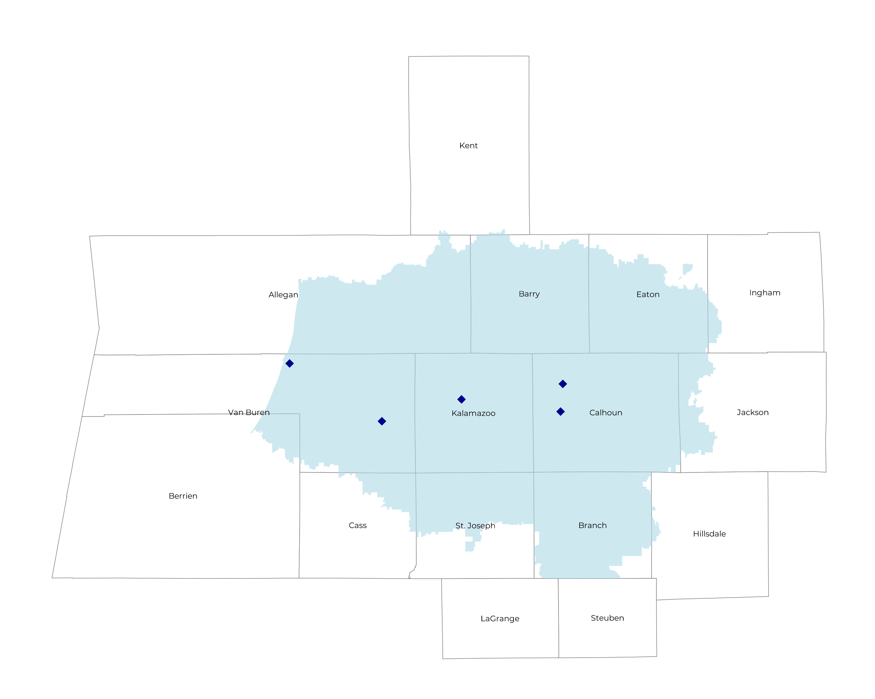
SIGNIFICANT OPPORTUNITY FOR PLAN GROWTH Researched for the below highlighted service area
Target Market 700+ Employers 165,000+ Employees 300,000+ Members
 | Employer Size Group (# of Employees)
Commercial Employers With Headquarters | 50-100 | 101-200 | 201-400 | 401-1,000 | 1,001-3,000 | 3,000+
In Catchment Area | 351 | 145 | 105 | 105 | 8 | 7
Total Employees at Employers | 50-100 | 101-200 | 201-400 | 401-1,000 | 1,001-3,000 | 3,000+
Headquartered in Catchment Area | 26,300 | 21,800 | 31,500 | 73,500 | 16,000 | 42,000
Total Members with Employers | 50-100 | 101-200 | 201-400 | 401-1,000 | 1,001-3,000 | 3,000+
Headquartered in Catchment Area | 47,300 | 39,200 | 56,700 | 132,300 | 28,800 | 75,600

Slide 8
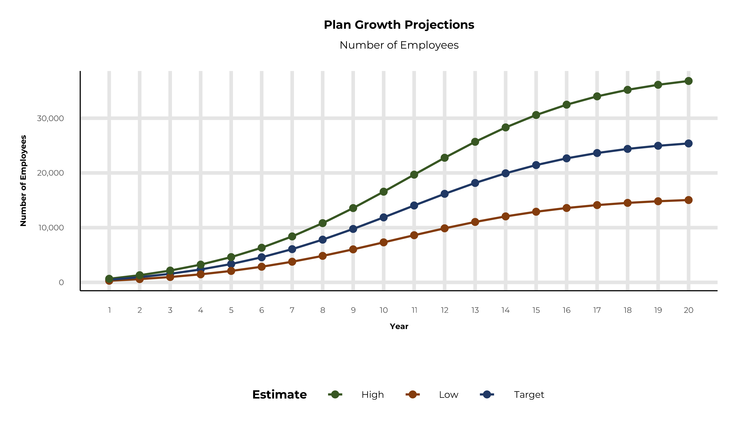
PLAN POTENTIAL GROWTH PATHS
Self Funded
174K
Insured
309K
Working Age
437K
Population
749K
Estimates includes the Bronson Healthcare service area in Allegan, Barry, Berrien, Branch, Calhoun, Cass, Eaton, Jackson, Kalamazoo, St. Joseph, and Van Buren Counties

Slide 9
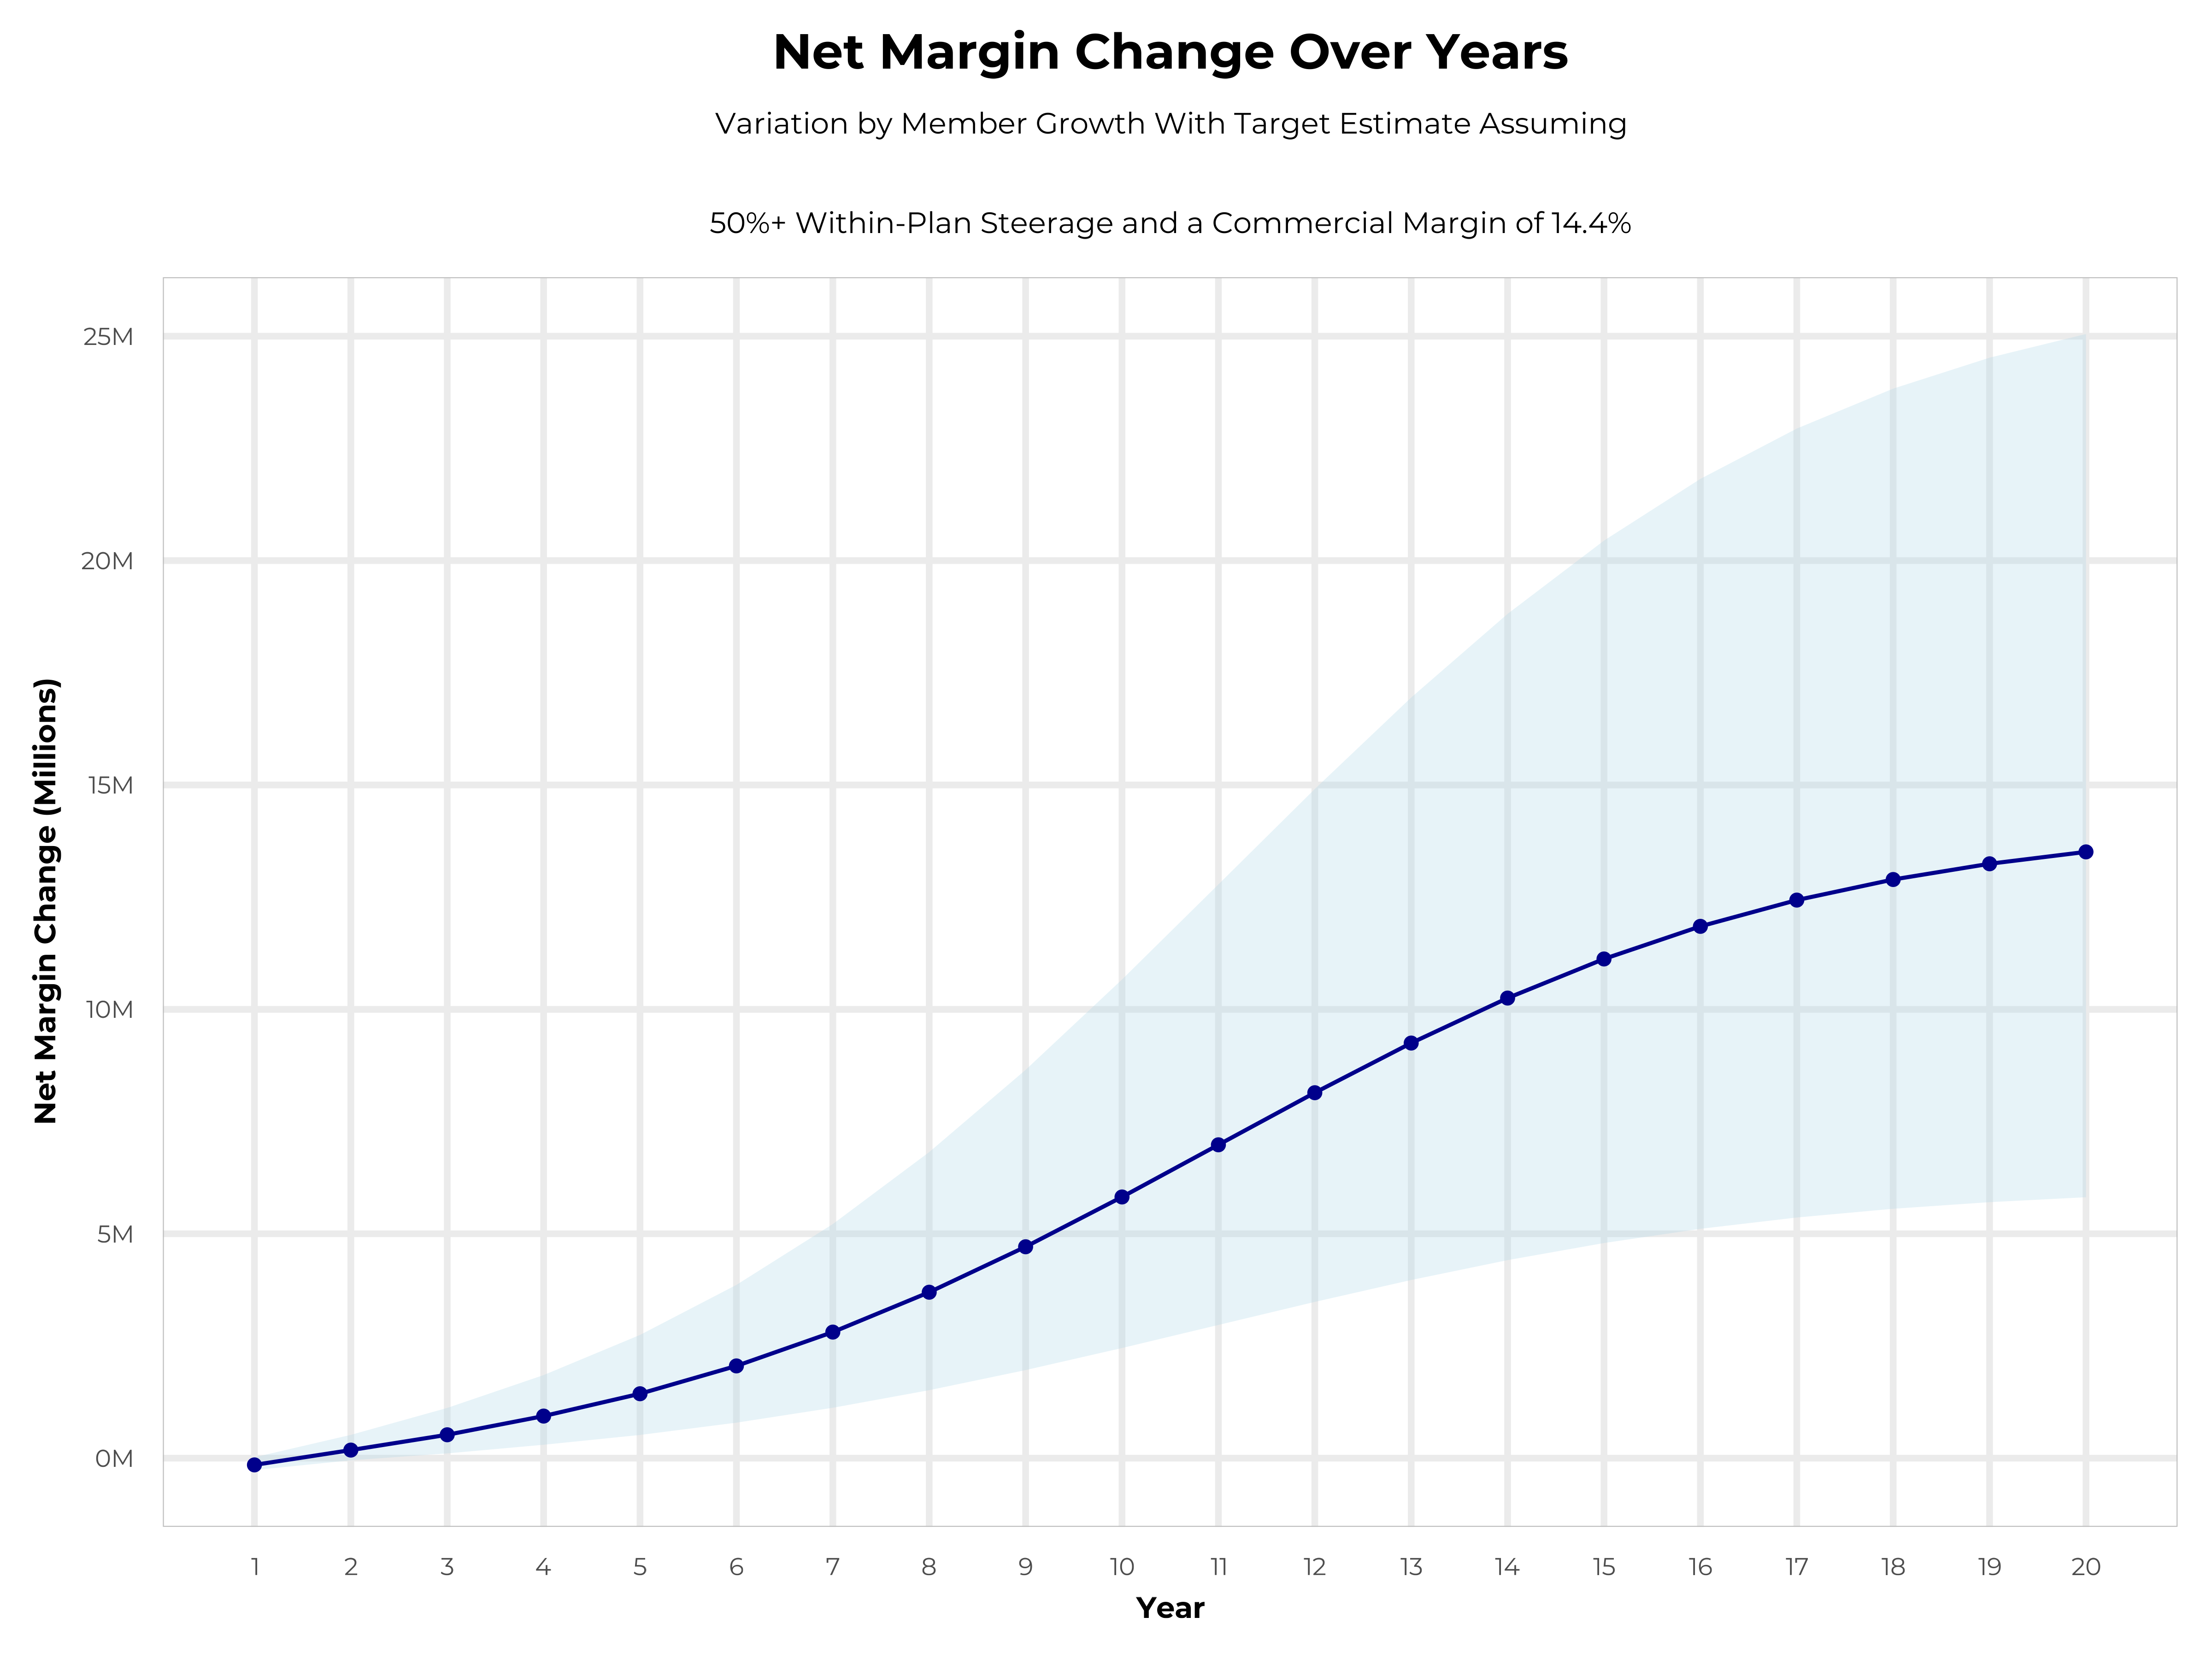
GROWING POWERFUL, LASTING PROFITABILITY
Early Stage
Gaining Name Recognition, Early Growth
New Revenue:
New Profit:
$6.82M
$0.83M
Growth Stage
Strong Reputation, Strong Growth
New Revenue:
New Profit:
$40.33M
$5.92M
Mature Stage
High Profitability, Market Saturation
New Revenue:
New Profit:
$82.01M
$12.19M

Slide 10
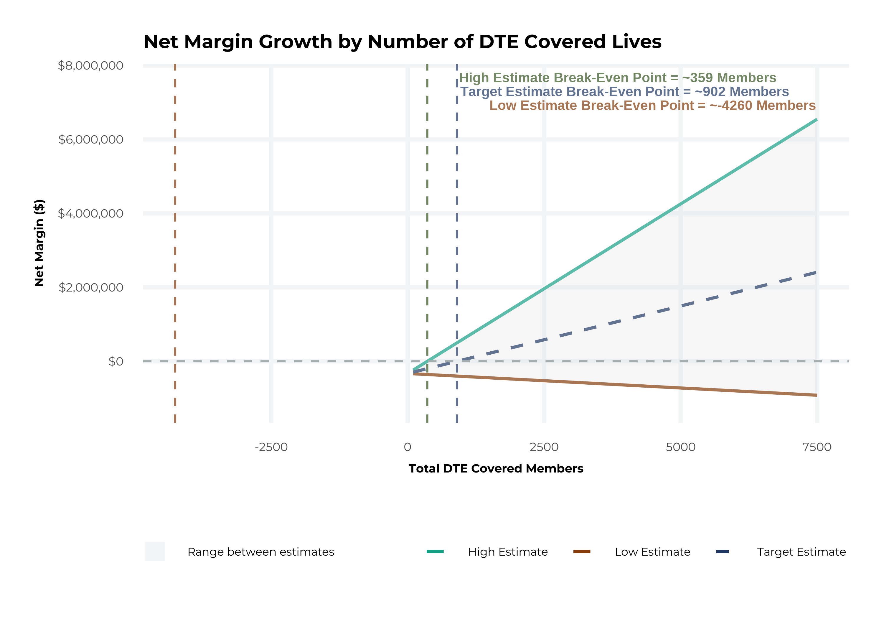
MODEL ASSUMPTIONS AND BREAK EVEN
Patient Steerage Assumptions
KBA currently estimates that Bronson Healthcare has 54% inpatient market share, and 35% outpatient market compared to hospitals/clinics in the Bronson Healthcare service area (see slide 8). The DTE tiered structure will create immediate steerage, with additional steerage over time from patient bonus benefits and the patient card (see slide 33 for estimates of target steerage).
Low
High
10% below target
10% above target
Commercial Margin Assumptions
KBA observes a Bronson Healthcare 18% commercial margin. Conservatively, we model the DTE to be even with commercial rates given prices 10% below market, but with a 10 percentage-point increase through friendlier billing practices and improved patient collections with the patient card.
Low
Target
High
9.4%
14.4%
19.4%

Slide 11
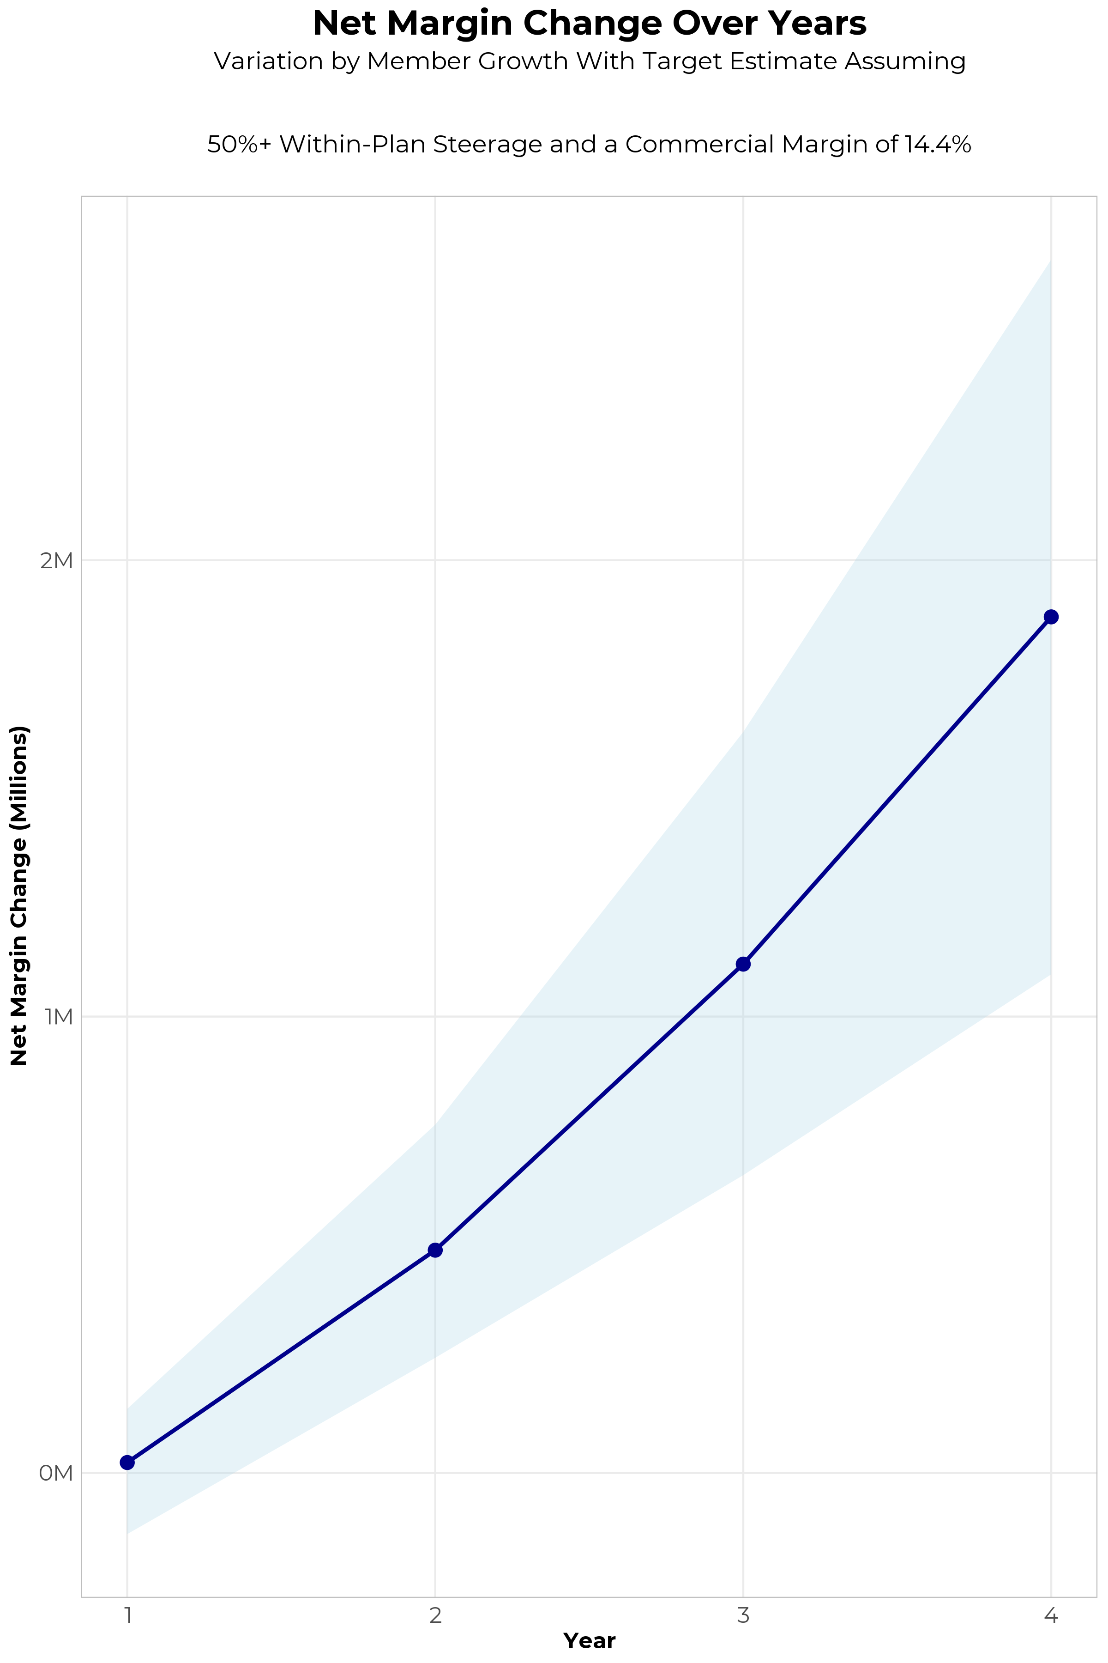
FOUR-YEAR PROJECTIONS
Target Member Growth | Target Member Growth | Target Member Growth | Target Member Growth | Target Member Growth
Metric | Year 1 | Year 2 | Year 3 | Year 4
Number of Members | 900 | 1,700 | 2,800 | 4,200
Incremental Margin | 328.5K | 622.2K | 1,219.3K | 1,942.4K
Network Access Fee | 24.3K | 45.9K | 75.6K | 113.4K
Implementation Fee (One-Time) | -150.0K | 0.0K | 0.0K | 0.0K
Sales and Marketing Costs | -180.0K | -180.0K | -180.0K | -180.0K
Net Margin Change | 22.8K | 488.1K | 1,114.9K | 1,875.8K
High Member Growth | High Member Growth | High Member Growth | High Member Growth | High Member Growth
Metric | Year 1 | Year 2 | Year 3 | Year 4
Number of Members | 1,200 | 2,400 | 3,900 | 5,800
Incremental Margin | 438.0K | 878.4K | 1,698.4K | 2,682.4K
Network Access Fee | 32.4K | 64.8K | 105.3K | 156.6K
Implementation Fee (One-Time) | -150.0K | 0.0K | 0.0K | 0.0K
Sales and Marketing Costs | -180.0K | -180.0K | -180.0K | -180.0K
Net Margin Change | 140.4K | 763.2K | 1,623.7K | 2,659.0K
Low Member Growth | Low Member Growth | Low Member Growth | Low Member Growth | Low Member Growth
Metric | Year 1 | Year 2 | Year 3 | Year 4
Number of Members | 500 | 1,100 | 1,800 | 2,600
Incremental Margin | 182.5K | 402.6K | 783.9K | 1,202.4K
Network Access Fee | 13.5K | 29.7K | 48.6K | 70.2K
Implementation Fee (One-Time) | -150.0K | 0.0K | 0.0K | 0.0K
Sales and Marketing Costs | -180.0K | -180.0K | -180.0K | -180.0K
Net Margin Change | -134.0K | 252.3K | 652.5K | 1,092.6K

Slide 12
DIRECT-TO-EMPLOYER STRATEGY: ONLY AVAILABLE TO PREMIER HEALTH SYSTEMS
STRONG Brand Quality
EXTENSIVE Patient Access
AFFORDABLE Value Pricing
EXCELLENT Care Quality

Slide 13
BRONSON IS PATIENT RECOMMENDED
Based on quality measures and HCAHPS feedback, KBA estimates that Bronson Healthcare has the strongest brand quality in Allegan, Barry, Berrien, Branch, Calhoun, Cass, Eaton, Jackson, Kalamazoo, St. Joseph, and Van Buren Counties.
Health System | HCAHPS Recommendation Percentile | CMS Stars Percentile | Mortality Percentile | Readmission Percentile | KBA Brand Quality Score
Bronson Healthcare | 59 | 90 | 56 | 72 | 64
Beacon Health System | 20 | 63 | 59 | 80 | 51

Slide 14
SINGLE YEAR SUMMARY
DTE Covered Members Financial Analysis | DTE Covered Members Financial Analysis | DTE Covered Members Financial Analysis | DTE Covered Members Financial Analysis | DTE Covered Members Financial Analysis | DTE Covered Members Financial Analysis | DTE Covered Members Financial Analysis | DTE Covered Members Financial Analysis
Target Estimate Assuming 50%+ Within-Plan Steerage and a Commercial Margin of 14.4%. | Target Estimate Assuming 50%+ Within-Plan Steerage and a Commercial Margin of 14.4%. | Target Estimate Assuming 50%+ Within-Plan Steerage and a Commercial Margin of 14.4%. | Target Estimate Assuming 50%+ Within-Plan Steerage and a Commercial Margin of 14.4%. | Target Estimate Assuming 50%+ Within-Plan Steerage and a Commercial Margin of 14.4%. | Target Estimate Assuming 50%+ Within-Plan Steerage and a Commercial Margin of 14.4%. | Target Estimate Assuming 50%+ Within-Plan Steerage and a Commercial Margin of 14.4%. | Target Estimate Assuming 50%+ Within-Plan Steerage and a Commercial Margin of 14.4%.
DTE Members | Pre-DTE Revenue | Pre-DTE Margin | DTE Revenue | DTE Incr. Revenue | DTE Total Margin | DTE Incr. Margin | Net Margin Less DTE Fees
100 | $ 435K | $ 63K | $ 680K | $ 245K | $ 98K | $ 35K | $ -292K
500 | $ 2,176K | $ 313K | $ 3,402K | $ 1,226K | $ 490K | $ 176K | $ -140K
1,000 | $ 4,353K | $ 627K | $ 6,804K | $ 2,451K | $ 980K | $ 353K | $ 50K
2,500 | $10,882K | $ 1,567K | $ 17,010K | $ 6,128K | $ 2,449K | $ 882K | $ 620K
10,000 | $43,526K | $ 6,268K | $ 68,038K | $24,512K | $ 9,797K | $3,530K | $3,470K
20,000 | $87,052K | $12,536K | $136,076K | $49,024K | $19,595K | $7,059K | $7,269K
NOTE: Please see detailed financial analysis and assumptions used starting on page 30.
Financial projections do not include 340B contribution margin, which could represent $136 PMPM by optimizing 340B through Rx plan design, Bronson Healthcare’s approved site(s) with network integration, and development of Bronson Healthcare’s proprietary PBM program.

Slide 15


INTEGRATION WITH EPIC EHR SYSTEM
KBA shares
evidence-based standards of care for 27 chronic conditions directly into Epic
Hyperthyroidism: Yearly Clinical Evaluation, TSH and T4

Slide 16

THE MISSING PIECE TO VALUE-BASED CARE
Patient engagement is the weak link in delivering value-based care; Bronson Healthcare’s clinical leadership and employer participation can drive better outcomes.
KBA’s proactive care-management team supplements your care-management efforts in outreach to clients.
Bronson Healthcare excels in Standards of Care completion rates for the Chronically Ill, improving care and costs.
Integrating Bronson Healthcare’s managed care with KBA’s programs positions Bronson Healthcare as the value leader.

Slide 17

TRANSPARENT PBM INTEGRATION
Support of Bronson Healthcare’s retail pharmacy(s)
Optimize Bronson Healthcare’s 340B drug
pricing program
Allows Bronson Healthcare to create its own PBM program if desired
Custom telephone number with personalized scripting and separate call tracking & reporting
Fully customizable member welcome booklet & materials
White labeled formulary document and marketing materials
CUSTOM CLIENT SUPPORT:
Specialized call center capabilities
Fully customizable plan designs
Operational access to the platform
Customized process and functions to promote DTE strategy
CLINICAL FLEXIBILITY:
Full portfolio of custom formulary offerings – with optimized formulary shield
Clinical programs that drive towards overall DTE strategy
Options for additional drug savings by driving members to lower cost alternatives
Flexibility to customize or layer on utilization management programs

Slide 18
STOP-LOSS INSURANCE THE KBA EXPERIENCE
Tokio Marine
Nationwide
Berkshire Hathaway
Sun Life
Liberty Mutual
Granular (Google)
Companion Life
Crum & Forster
American Fidelity
RGA
Deep relationships with 20+ stop loss underwriters and carriers
Over $150M in annual stop loss premium placement
Comprehensive pricing and medical service analysis performed for each DTE health plan to ensure proper pricing
KBA provides the administration required of the stop-loss markets:
Bordereau Reporting
Claim Reporting and Reconciliation
Evaluation of Networks
Care Management
Initial Underwriting
Negotiation of rates and terms
Plan Design Actuarial

Slide 19

DTE PROGRAM MARKETING & SALES
KBA WORKS WITH YOU TO MANAGE & SELL:
Branding & Messaging
Direct & Brokerage Sales Distribution – Focused Sales Representative
Brochures, Web Site, Media, etc.
Stop-Loss/Level Funded Down to 20 EE Lives
Sell Through Established Brokers in Your Service Area

Slide 20

COMMUNITY BASED SALES STRATEGY
Locally based sales rep with strong community ties
Collaboration with DTE provider partners to identify strategic employers for early adoption and sales
Work with select broker distribution partners with aligned incentives and goals
Pipeline reporting and collaboration with our DTE provider partners
Marketing and promotion of the new option in the community

Slide 21


Complete Marketing System
Customized Branding and Messaging
Customized Brochures
Customized Web Site
Targeted Employer Outreach
Sales System (Social Media, Email, Text, etc.)

Slide 22
The Key Incentive Plan
Base Medical + Preferred Plus Benefits = Your Deductible Can Simply Vanish
Example: Member with a $2,500 deductible / $4,500 max out-of-pocket has a heart attack and cardiac surgery, resulting in a 5-day in-patient stay. In this example, the member would have a $4,500 OOP with $5,050 Preferred Plus Benefits for a net OOP $0 due to the preferred provider versus $4,500 OOP exposure at any non-preferred provider.
BASE MEDICAL BENEFITS* |  |  | PREFERRED PLUS BENEFITS
Deductible |  |  | Benefits automatically included in your plan!
Single | $2,500 |  |  | Preferred Provider | Non-Preferred Provider
Family | $4,500 |  | OP Radiology/X-Ray | $200 | $0
Coinsurance |  |  | OP Diagnostic Labs | $100 | $0
80% / 20% |  |  | Preferred Hospital Stay ($500/day, 5 days) | $2,500 | $0
Maximum Out-of-Pocket |  |  | Critical Illness Benefit | $2,000 | $0
Single | $4,500 |  | Health Screening Benefit | $125 | $0
Family | $9,000 |  | Total Employee OOP | $4,500 | $4,500
Chronic Disease Management Regimens of Care Covered at 100% |  |  | Preferred Plus Benefits | $4,925 | $0
Healthcare Convience Card to Cover Out-of-Pocket Expenses at 0% interest |  |  | Employee Amount Due to Provider | $0 | $4,500
Health Guardian Account to help members manage their healthcare expenses at Preferred Providers |  |  | Additional Benefit Payable to the Health Guardian Account | $425 | $0
*Base Medical Benefits are for illustration purposes only. Base benefits can be customized to meet client needs.

Slide 23

THE BENEFIT STEERING THE PATIENT TO BRONSON HEALTHCARE
What Will this Claim Cost Me?
Explanation of Benefits
Heart Attack, Cardiac Surgery
THE CHARGES
Medical Bills | $25,000
Healthcare out-of-pocket due to provider | $4,500
Since your out of pocket maximum has been met, the rest of your eligible charges this year will be paid at 100%
THE CREDITS
OP Radiology/X-Ray | $200
OP Diagnostic Labs | $100
Preferred Hospital Stay ($500/day, 5 days) | $2,500
Critical Illness Benefit | $2,000
Health Screening Benefit | $125
Benefit Total | $4,925
Out of Pocket Paid to Hospital | ($4,500)
Balance Paid to HGA | $425
Bronson Healthcare patients can have all out-of-pocket liability reduced to $0!
Notes:
Can’t put 3,500 on the convenience card. Second line is not the healthcare credicard balance

Slide 24

THE KBA HEALTHCARE CONVENIENCE CARD
Creating EPO Steerage in a PPO Network
The Healthcare Convenience Card is eligible to be used only for specific merchant codes.
To utilize at Specific Healthcare Providers
a. Designated Hospitals
b. Urgent Care Facilities
c. Physicians
d. Eligible Ancillary Providers
Out of Pocket Expenses Qualify
0% Interest Rate
Employee Determines Repayment Schedules
5. To Qualify: Answer One Simple Question
Notes:
Replace with slide 1 of updates provided by Jan, but update design to match the rest of ppt

Slide 25

Claims Processing Excellence
Delivering a positive member and provider experience starts with accurate, efficient, and transparent claims processing
Key Benefit Administrators leverages:
Proven technology
Steamlined workflows
A team dedicated to first pass accuracy
We Consistently:
Exceed industry standard turnaround times and quality metrics
Reduce administrative burdens
Maintain high member and provider satisfaction
Strategic Partnerships:
We partner with Smart Data Solutions for clearinghouse services to empower providers with electronic claims submission and transparency tools.
Currently 82% of our claim volume is received electronically.
Ongoing efforts to increase electronic submissions:
Analyze paper and non-electronic claims
Proactively engage providers for electronic claim setup
We also partner with top tier vendors to provide cost containment solutions to include:
Out of network discounts
High dollar bill reviews
Specialized networks for high-cost conditions such as transplants and dialysis.

Slide 26
Claims Statistics
Claims | Industry Standard | Corporate Goal | Self-Funded Medical Achieved*
Turn Around Time | 10 calendar days | 7 calendar days | 4.25 calendar days
% Paid in 10 days | 80% | 85% | 86.7%
Financial Quality | 99% | 99% | 99.6%
Payment Accuracy | NA | 95% | 97.4%
* Data achieved is for Jan-Jun 2025 calendar year
Groups are provided with a dedicated specialist to handle escalated issues and concerns promptly.
We offer comprehensive, interactive training for claims and customer service staff to prepare them for their roles, using a collaborative LMS system to ensure consistency and accuracy in KBA processes.

Slide 27
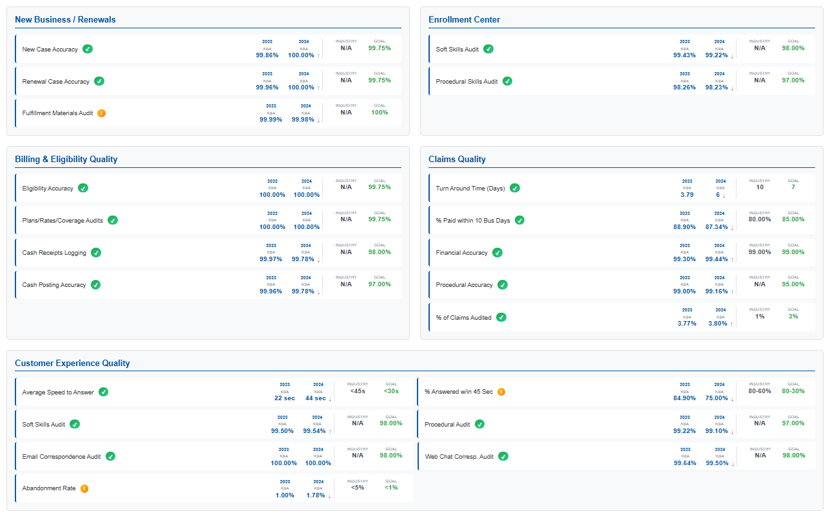



KBA 2023-2024 Total Quality Management Statistics

Slide 28
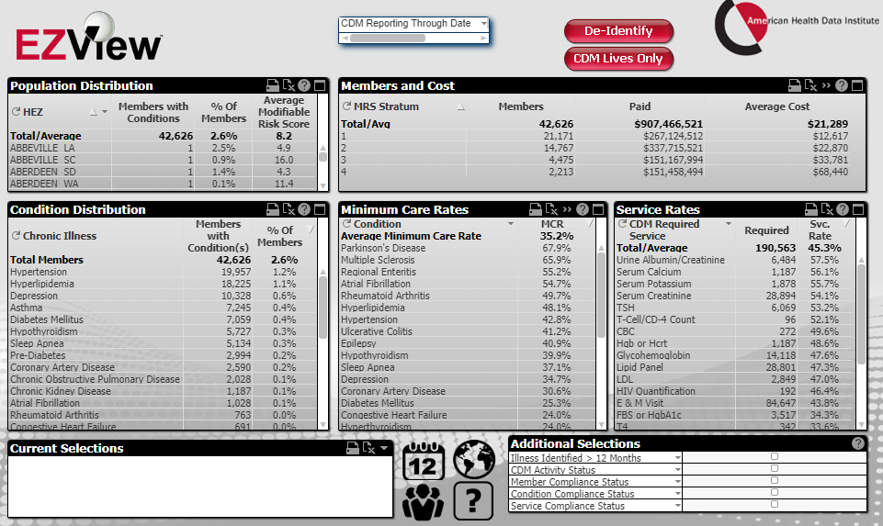
TRANSPARENT ANALYTICS ACCESS
EZView analytics platform provides instant access to critical analytics insights.
Filter to a population by data source, group, plan, or geographic location.
Identifications of chronic conditions, patient acuity, compliance with nurse coaching, regimens of care, steerage rates or claims costs.

Slide 29
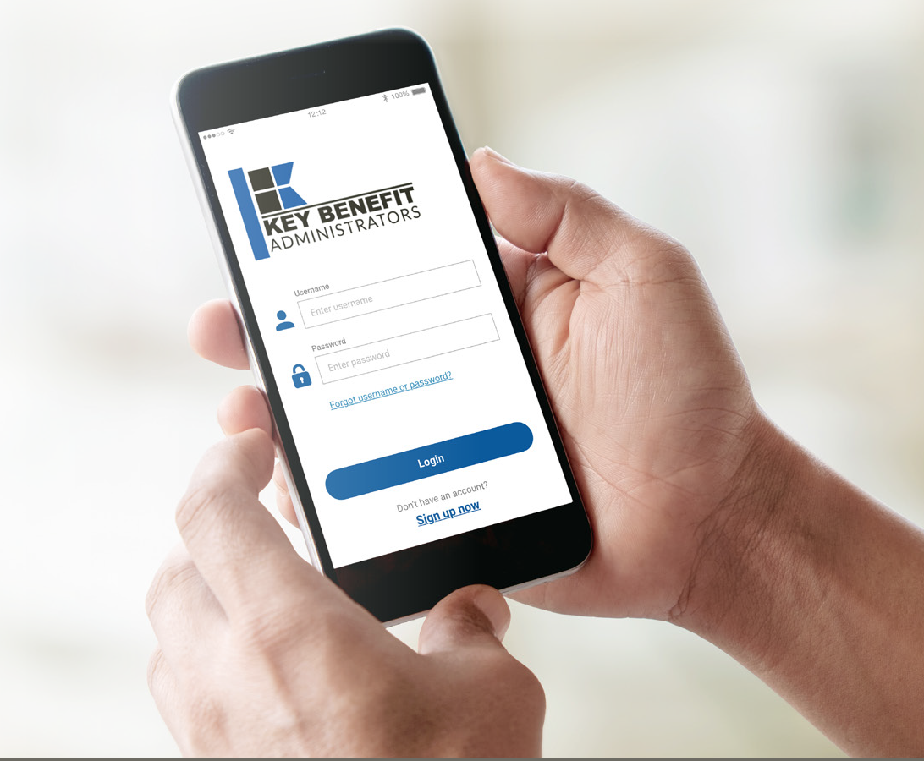

Web Portal and Mobile Application
Gives you accessibility to your benefit plan information, claims data, eligibility details and much more!
Biometric Login for ease of access (Fingerprint & Facial Recognition)
Simplified Accumulator View
Recent Claims Summary and Full Detail
Benefit Information
View/Request an ID Card (Display - Print – Fax – Email)
SSO directly to Vendor Solutions
Rx Price Comparison and Pharmacy Discount Programs (if applicable)
Express Requests to Customer Support
Push Notifications (Mobile App)
Gives you accessibility to your benefit plan information, claims data, eligibility details and so much more!
• Dashboard with menu options
• Claim Status
• Benefit Information
• View/Request an ID Card
• Geofencing
• Push Notifications
• Rx Price Comparison
• Customer Service

Slide 30

FINANCIAL PROJECTIONS
& ASSUPTIONS

Slide 31
ESTIMATION OF BRONSON’S 2022 PAYER MIX
Payer Group | Total Inpatient Days | Revenue | Payer Mix
All Bronson Healthcare | 152,318 | $1,631,551K | 100%
Medicare | 32,298 | $172,498K | 20%
Medicaid | 7,975 | $238,445K | 5%
Other Government Pay | 0
No-Pay, Charity Care | 2,339 | -$26,290K | 1%
Commercial/Self Pay | 109,706 | $1,219,470K | 73%
Estimating Payer Mix
Medicare, Medicaid, and other government payer mixes are estimated as the percentage of inpatient days for each group divided by total inpatient days.
No-pay and charity care is estimated as the percentage of no-pay/charity care compared to total overall revenue.
Commercial/self pay is assumed to be the rest of the total payer mix share.
Estimating Total Inpatient Days
Total inpatient days for ‘No Pay’ and ‘Commercial’ are estimated to be the payer mix estimates for “No Pay, Charity Care” and “Commercial/Self Pay” multiplied by the total number of inpatient days.
Values in blue are taken from the 2022 Medicare Provider Cost Report (https://data.cms.gov/provider-compliance/cost-report/hospital-provider-cost-report/data)
In other analysis, the outpatient payer mix is assumed to mirror the inpatient payer mix.
Values in yellow are taken from Definitive Healthcare data.
Total Medicare patient revenue is reported by CMS in the Medicare Provider Analysis and Review Report (MedPAR)

Slide 32
ESTIMATION OF MARGIN FOR COMMERCIAL VS. GOVERNMENT PAY
The RAND data for Bronson Healthcare estimates commercial insurance reimbursements at 210% of Medicare Rates
Estimating Commercial Margin
(Calculated through counterfactual of assuming all CMS/Government pay was paying at commercial rates)
Estimating Gov-Pay Margin
(Calculated through counterfactual of assuming all commercial pay was paying at Medicare rate)
Commercial Revenue | $1,219,470K
Gov-pay revenue at 210% current rate | $864,903K
Total Revenue | $2,084,372K
Total Costs | $1,708,093K
Net Income | $376,279K
 | 18%
Commercial Revenue Divided by 210% | $579,410K
Gov-pay revenue | $410,943K
Total Revenue | $990,353K
Total Costs | $1,708,093K
Net Income | $ -717,741K
 | -72%

Slide 33
ESTIMATING MARKET SHARE
Hospital Name | Number of Beds | Inpatient Total Charges | Outpatient Total Charges | Inpatient Percent of Market Total | Outpatient Percent of Market Total (Assuming 66% of Physicians Employed by Hospitals)
Bronson Methodist Hospital | 415 | $1,216,696.4K | $1,961,411.8K | 43% | 24%
Bronson Battle Creek Hospital | 139 | $ 288,266.6K | $ 628,975.5K | 10% | 8%
Bronson South Haven Hospital | 8 | $ 9,736.9K | $ 102,106.6K | <1% | 1%
Bronson LakeView Hospital | 16 | $ 13,514.7K | $ 171,975.3K | <1% | 2%
Bronson Behavioral Health Hospital | 69 | $ 47,030.5K | $ NAK | 2% | NA%
Three Rivers Health Hospital | 48 | $ 30,311.9K | $ 164,956.0K | 1% | 2%
Insight Hospital & Medical Center Coldwater | 75 | $ 57,960.5K | $ 408,589.2K | 2% | 5%
Corewell Health Watervliet Hospital | 26 | $ 23,543.2K | $ 117,863.3K | 1% | 1%
Beacon Kalamazoo | 236 | $ 759,174.5K | $ 795,124.7K | 27% | 10%
Battle Creek VA Medical Center | 276 | $ NAK | $ NAK | NA% | NA%
Oaklawn Hospital | 78 | $ 117,191.0K | $ 475,754.7K | 4% | 6%
Eaton Rapids Medical Center | 20 | $ 3,234.4K | $ 61,042.5K | <1% | 1%
UM Health - Sparrow Eaton | 25 | $ 16,192.8K | $ 161,602.9K | 1% | 2%
Beacon Allegan | 25 | $ 5,048.7K | $ 65,318.3K | <1% | 1%
Corewell Health Pennock Hospital | 25 | $ 25,416.0K | $ 258,624.5K | 1% | 3%
Beacon Plainwell | 43 | $ 20,429.5K | $ 58,009.1K | 1% | 1%
Select Specialty Hospital - Battle Creek | 25 | $ 121,405.7K | $ NAK | 4% | NA%
Kalamazoo Psychiatric Hospital | 123 | $ 61,559.4K | $ NAK | 2% | NA%
54% Inpatient Market Share
35% Outpatient Market Share
For outpatient market share, it is estimated that only 66% of local physicians are employed by area hospitals (Research from the Physician Advocacy Institute: https://www.physiciansadvocacyinstitute.org/Portals/0/assets/docs/PAI-Research/PAI-Avalere%20Physician%20Employment%20Trends%20Study%202019-2023%20Final.pdf?ver=uGHF46u1GSeZgYXMKFyYvw%3d%3d)

Slide 34
Hospital Metrics | Hospital Metrics | Hospital Metrics | Hospital Metrics | Hospital Metrics
Metric | Bronson Methodist Hospital | Bronson Battle Creek Hospital | Bronson South Haven Hospital | Bronson LakeView Hospital
Total Inpatient Patient Revenue | $464,778K | $92,245K | $3,544K | $6,068K
Total Outpatient Patient Revenue | $749,259K | $201,272K | $37,167K | $77,217K
Total Medicare Revenue | $126,937K | $40,566K | $2,707K | $2,289K
Estimated Medicaid and Other Government-Pay Revenue | $168,606K | $49,157K | $9,834K | $10,849K
Estimated Commercial Revenue | $916,993K | $204,156K | $28,108K | $70,213K
Total Uncompensated Care | $16,530K | $6,099K | $1,473K | $2,189K
Estimated Inpatient Costs | $482,147K | $106,593K | $3,692K | $4,889K
Estimated Outpatient Costs | $777,259K | $232,578K | $38,718K | $62,217K
Total Operating Expenses | $1,259,406K | $339,171K | $42,410K | $67,106K
Net Income | $-46,870K | $-45,293K | $-1,762K | $16,245K
Estimated Payer Mix Percent Medicare | 18.4% | 29.4% | 33.3% | 35.0%
Estimated Payer Mix Percent Medicaid | 5.4% | 5.1% | 3.3% | 2.9%
Estimated Payer Mix Percent Other Government-Pay | 0.0% | 0.0% | 0.0% | 0.0%
Payer Mix Percent No Pay | 1.3% | 2.0% | 3.5% | 2.6%
Estimated Payer Mix Percent Commercial | 74.9% | 63.5% | 59.9% | 59.5%
Estimated Commercial Profit Margin | 18.2% | 13.7% | 22.2% | 31.4%
1. Most data is taken from the CMS provider cost report | 1. Most data is taken from the CMS provider cost report | 1. Most data is taken from the CMS provider cost report | 1. Most data is taken from the CMS provider cost report | 1. Most data is taken from the CMS provider cost report
2. Medicare costs are taken from the Medicare Provider Analysis and Review (MedPAR) | 2. Medicare costs are taken from the Medicare Provider Analysis and Review (MedPAR) | 2. Medicare costs are taken from the Medicare Provider Analysis and Review (MedPAR) | 2. Medicare costs are taken from the Medicare Provider Analysis and Review (MedPAR) | 2. Medicare costs are taken from the Medicare Provider Analysis and Review (MedPAR)
3. Data with 'Estimated' in the title are derived from other data points. | 3. Data with 'Estimated' in the title are derived from other data points. | 3. Data with 'Estimated' in the title are derived from other data points. | 3. Data with 'Estimated' in the title are derived from other data points. | 3. Data with 'Estimated' in the title are derived from other data points.
4. Market Share estimates based on total patient revenues with area hospitals. Ambulatory market share based on regional estimates of the percentage of local physicians employed by area hospitals. See Physician Advocacy Institute | 4. Market Share estimates based on total patient revenues with area hospitals. Ambulatory market share based on regional estimates of the percentage of local physicians employed by area hospitals. See Physician Advocacy Institute | 4. Market Share estimates based on total patient revenues with area hospitals. Ambulatory market share based on regional estimates of the percentage of local physicians employed by area hospitals. See Physician Advocacy Institute | 4. Market Share estimates based on total patient revenues with area hospitals. Ambulatory market share based on regional estimates of the percentage of local physicians employed by area hospitals. See Physician Advocacy Institute | 4. Market Share estimates based on total patient revenues with area hospitals. Ambulatory market share based on regional estimates of the percentage of local physicians employed by area hospitals. See Physician Advocacy Institute

Slide 35

STEERAGE RATES FOR CURRENT DTE NETWORKS
The average Tier 1 Steerage is 83%.
* Data collected from KBA DTE Networks in Q1 2024

Slide 36
PROJECTED PLAN GROWTH
Year | Employees | Members | Percent of Members Choosing Bronson Healthcare for Inpatient Care | Percent of Members Choosing Bronson Healthcare for Outpatient Care
1 | 500 | 900 | 70% | 60%
2 | 1,000 | 1,800 | 70% | 60%
3 | 1,600 | 2,900 | 73% | 65%
4 | 2,400 | 4,300 | 74% | 67%
5 | 3,400 | 6,100 | 74% | 68%
6 | 4,600 | 8,300 | 74% | 68%
7 | 6,100 | 11,000 | 74% | 69%
8 | 7,800 | 14,000 | 74% | 69%
9 | 9,800 | 17,600 | 74% | 69%
10 | 11,900 | 21,400 | 75% | 70%
11 | 14,000 | 25,200 | 75% | 70%
12 | 16,200 | 29,200 | 75% | 70%
13 | 18,200 | 32,800 | 75% | 71%
14 | 19,900 | 35,800 | 75% | 71%
15 | 21,400 | 38,500 | 75% | 71%
16 | 22,700 | 40,900 | 75% | 72%
17 | 23,600 | 42,500 | 75% | 72%
18 | 24,400 | 43,900 | 75% | 72%
19 | 25,000 | 45,000 | 75% | 72%
20 | 25,400 | 45,700 | 76% | 72%
KBA currently estimates that Bronson Healthcare has 54% inpatient market share, and 35% outpatient market compared to hospitals/clinics in the Bronson Healthcare service area (see slide 8).
Based on previous DTE experience, KBA expects a significant bump in patient steerage to Bronson Healthcare.
Additional steerage will occur from additional steerage patient benefits and the patient card.
High estimates start nearly 10% higher than target with low estimates at 10% lower than target

Slide 37
YEAR 4 PROJECTED REVENUE AND PROFIT
Pre-DTE Cohort of 4,200 Employees | Inpatient | Outpatient | Professional | Total
Revenue† | $ 6,743,112 | $ 7,864,980 | $ 3,672,879 | $ 18,280,970
Net Income‡ | $ 971,008.1 | $ 1,132,557 | $ 528,894.5 | $ 2,632,460
† Assuming proportional revenues from market shares of 54% (inpatient) and 35% (outpatient)
‡ Conservatively assuming a commercial margin of 14.4% (80% of the estimated commercial margin)
With DTE | Inpatient | Outpatient | Professional | Total
Revenue⁰ | $ 9,167,006 | $ 15,169,058 | $ 7,083,821 | $ 31,419,885
Net Income* | $ 1,320,049 | $ 2,184,344 | $ 1,020,070 | $ 4,524,463
⁰ Assuming 74% inpatient and 67% market steerage based on KBA narrow network DTE experience (see previous slide)
* Conservatively assuming a commercial margin of 14.4%, with a 10 percentage-point reduction to reflect competitive-edge rates and a 10 percentage-point increase due to lower billing costs and higher patient responsibility collections because of the member convenience card.
Total Increase in Net Income | $ 1,892,004
Network Access Fee (Revenue) of $2.25 PMPM | $ 113,400
Total Profit Growth | $ 2,005,404
Minus Implementation Fee (One-Time) | -$ 0
Minus Sales and Marketing (Annual – Ongoing) | -$ 180,000
Total | $ 1,825,404

Slide 38
Target Estimate Assuming 50%+ Within-Plan Steerage and a Commercial Margin of 14.4% | Target Estimate Assuming 50%+ Within-Plan Steerage and a Commercial Margin of 14.4% | Target Estimate Assuming 50%+ Within-Plan Steerage and a Commercial Margin of 14.4% | Target Estimate Assuming 50%+ Within-Plan Steerage and a Commercial Margin of 14.4% | Target Estimate Assuming 50%+ Within-Plan Steerage and a Commercial Margin of 14.4%
All values in thousands of dollars. Modeled With Year 1 Fees and Patient Steerage. | All values in thousands of dollars. Modeled With Year 1 Fees and Patient Steerage. | All values in thousands of dollars. Modeled With Year 1 Fees and Patient Steerage. | All values in thousands of dollars. Modeled With Year 1 Fees and Patient Steerage. | All values in thousands of dollars. Modeled With Year 1 Fees and Patient Steerage.
Metric | 500 DTE Covered Lives | 1000 DTE Covered Lives | 5000 DTE Covered Lives | 25000 DTE Covered Lives
Pre-DTE Group Inpatient Revenue | $802.8 | $1,605.5 | $8,027.5 | $40,137.6
Pre-DTE Group Inpatient Margin | $115.6 | $231.2 | $1,156.0 | $5,779.8
DTE Group Inpatient Revenue | $1,035.1 | $2,070.2 | $10,350.9 | $51,754.3
DTE Group Inpatient Margin | $149.1 | $298.1 | $1,490.5 | $7,452.6
DTE Group Incremental Inpatient Revenue | $232.3 | $464.7 | $2,323.3 | $11,616.7
DTE Group Incremental Inpatient Margin | $33.5 | $66.9 | $334.6 | $1,672.8
Pre-DTE Group Outpatient Revenue | $936.3 | $1,872.6 | $9,363.1 | $46,815.4
Pre-DTE Group Outpatient Margin | $134.8 | $269.7 | $1,348.3 | $6,741.4
DTE Group Outpatient Revenue | $1,613.4 | $3,226.8 | $16,133.8 | $80,669.2
DTE Group Outpatient Margin | $232.3 | $464.7 | $2,323.3 | $11,616.4
DTE Group Incremental Outpatient Revenue | $677.1 | $1,354.2 | $6,770.8 | $33,853.8
DTE Group Incremental Outpatient Margin | $97.5 | $195.0 | $975.0 | $4,874.9
Pre-DTE Group Professional Revenue | $437.2 | $874.5 | $4,372.5 | $21,862.4
Pre-DTE Group Professional Margin | $63.0 | $125.9 | $629.6 | $3,148.2
DTE Group Professional Revenue | $753.4 | $1,506.9 | $7,534.4 | $37,671.8
DTE Group Professional Margin | $108.5 | $217.0 | $1,084.9 | $5,424.7
DTE Group Incremental Professional Revenue | $316.2 | $632.4 | $3,161.9 | $15,809.4
DTE Group Incremental Professional Margin | $45.5 | $91.1 | $455.3 | $2,276.6
Net Margin Less DTE Fees | $-140.0 | $50.0 | $1,569.9 | $9,169.3

Slide 39
Target Estimate Assuming 50%+ Within-Plan Steerage and a Commercial Margin of 14.4% | Target Estimate Assuming 50%+ Within-Plan Steerage and a Commercial Margin of 14.4% | Target Estimate Assuming 50%+ Within-Plan Steerage and a Commercial Margin of 14.4% | Target Estimate Assuming 50%+ Within-Plan Steerage and a Commercial Margin of 14.4% | Target Estimate Assuming 50%+ Within-Plan Steerage and a Commercial Margin of 14.4%
All values in thousands of dollars. Modeled With Year 1 Fees and Patient Steerage. | All values in thousands of dollars. Modeled With Year 1 Fees and Patient Steerage. | All values in thousands of dollars. Modeled With Year 1 Fees and Patient Steerage. | All values in thousands of dollars. Modeled With Year 1 Fees and Patient Steerage. | All values in thousands of dollars. Modeled With Year 1 Fees and Patient Steerage.
Metric | 500 DTE Covered Lives | 1000 DTE Covered Lives | 5000 DTE Covered Lives | 25000 DTE Covered Lives
Pre-DTE Group Total Revenue | $2,176.3 | $4,352.6 | $21,763.1 | $108,815.3
Pre-DTE Group Total Margin | $313.4 | $626.8 | $3,133.9 | $15,669.4
DTE Group Total Revenue | $3,401.9 | $6,803.8 | $34,019.1 | $170,095.3
DTE Group Incremental Total Revenue | $1,225.6 | $2,451.2 | $12,256.0 | $61,280.0
Incremental Total Revenue by Member | $2.5 | $2.5 | $2.5 | $2.5
DTE Group Total Margin | $489.9 | $979.7 | $4,898.7 | $24,493.7
DTE Group Incremental Total Margin | $176.5 | $353.0 | $1,764.9 | $8,824.3
Wellness Share | $13.5 | $27.0 | $135.0 | $675.0
Implementation Fee (One-Time) | $150.0 | $150.0 | $150.0 | $150.0
Sales and Marketing Annual Fee | $180.0 | $180.0 | $180.0 | $180.0
Net Margin Less DTE Fees | $-140.0 | $50.0 | $1,569.9 | $9,169.3

Slide 40
High Estimate Assuming 60%+ Within-Plan Steerage and a Commercial Margin of 19.4% | High Estimate Assuming 60%+ Within-Plan Steerage and a Commercial Margin of 19.4% | High Estimate Assuming 60%+ Within-Plan Steerage and a Commercial Margin of 19.4% | High Estimate Assuming 60%+ Within-Plan Steerage and a Commercial Margin of 19.4% | High Estimate Assuming 60%+ Within-Plan Steerage and a Commercial Margin of 19.4%
All values in thousands of dollars. Modeled With Year 1 Fees and Patient Steerage. | All values in thousands of dollars. Modeled With Year 1 Fees and Patient Steerage. | All values in thousands of dollars. Modeled With Year 1 Fees and Patient Steerage. | All values in thousands of dollars. Modeled With Year 1 Fees and Patient Steerage. | All values in thousands of dollars. Modeled With Year 1 Fees and Patient Steerage.
Metric | 500 DTE Covered Lives | 1000 DTE Covered Lives | 5000 DTE Covered Lives | 25000 DTE Covered Lives
Pre-DTE Group Total Revenue | $2,176.3 | $4,352.6 | $21,763.1 | $108,815.3
Pre-DTE Group Total Margin | $313.4 | $626.8 | $3,133.9 | $15,669.4
DTE Group Total Revenue | $3,947.8 | $7,895.6 | $39,478.1 | $197,390.4
DTE Group Incremental Total Revenue | $1,771.5 | $3,543.0 | $17,715.0 | $88,575.1
DTE Group Total Margin | $765.9 | $1,531.7 | $7,658.7 | $38,293.7
DTE Group Incremental Total Margin | $452.5 | $905.0 | $4,524.9 | $22,624.3
Wellness Share | $13.5 | $27.0 | $135.0 | $675.0
Implementation Fee (One-Time) | $150.0 | $150.0 | $150.0 | $150.0
Sales and Marketing Annual Fee | $180.0 | $180.0 | $180.0 | $180.0
Net Margin Less DTE Fees | $136.0 | $602.0 | $4,329.9 | $22,969.3

Slide 41
Low Estimate Assuming 45%+ Within-Plan Steerage and a Commercial Margin of 9.4% | Low Estimate Assuming 45%+ Within-Plan Steerage and a Commercial Margin of 9.4% | Low Estimate Assuming 45%+ Within-Plan Steerage and a Commercial Margin of 9.4% | Low Estimate Assuming 45%+ Within-Plan Steerage and a Commercial Margin of 9.4% | Low Estimate Assuming 45%+ Within-Plan Steerage and a Commercial Margin of 9.4%
All values in thousands of dollars. Modeled With Year 1 Fees and Patient Steerage. | All values in thousands of dollars. Modeled With Year 1 Fees and Patient Steerage. | All values in thousands of dollars. Modeled With Year 1 Fees and Patient Steerage. | All values in thousands of dollars. Modeled With Year 1 Fees and Patient Steerage. | All values in thousands of dollars. Modeled With Year 1 Fees and Patient Steerage.
Metric | 500 DTE Covered Lives | 1000 DTE Covered Lives | 5000 DTE Covered Lives | 25000 DTE Covered Lives
Pre-DTE Group Total Revenue | $2,176.3 | $4,352.6 | $21,763.1 | $108,815.3
Pre-DTE Group Total Margin | $313.4 | $626.8 | $3,133.9 | $15,669.4
DTE Group Total Revenue | $2,852.7 | $5,705.4 | $28,526.8 | $142,634.0
DTE Group Incremental Total Revenue | $676.4 | $1,352.7 | $6,763.7 | $33,818.7
DTE Group Total Margin | $268.2 | $536.3 | $2,681.5 | $13,407.6
DTE Group Incremental Total Margin | $-45.2 | $-90.5 | $-452.4 | $-2,261.8
Wellness Share | $13.5 | $27.0 | $135.0 | $675.0
Implementation Fee (One-Time) | $150.0 | $150.0 | $150.0 | $150.0
Sales and Marketing Annual Fee | $180.0 | $180.0 | $180.0 | $180.0
Net Margin Less DTE Fees | $-361.7 | $-393.5 | $-647.4 | $-1,916.8

Slide 42
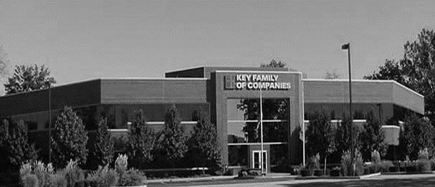



COLLABORATION OF STAKEHOLDERS
Key Benefit Administrators
Employer
Employee
Full TPA Administration
Stop-Loss Administration
True Transparency & Analytics
Population Health Management
Utilization & Case Management
Sales & Marketing
Transparent PBM
Website & Mobile App
Customizable options & plans
Incremental Revenues and Margin
Branding & Messaging
Benefit Plan Integration
Network Steerage
Direct Relationship with Self-Funded Employers
Referral Authorization
Plan Transparency
Direct Access to Members
Reduced Out of Pocket
Improved Health
Better Coordination & Navigation of Care
Direct Access to the Best Medical Providers
Bronson Healthcare’s DTE
Reduced Spend
“At The Table” with Bronson Healthcare
Improved Analytics
Complete Transparency
Lower Stop-Loss
Benefit Plan Stabilization
Healthier Population

Slide 43
ROLES & RESPONSIBILITIES
SERVICES & ADMINISTRATIVE SYSTEMS PROVIDED BY:
Bronson Healthcare | KBA Operations
Tier 1 Provider Network Provider Recruitment – If Necessary Network Pricing & Contract Terms Referral Management Protocols & Approvals Medical Director Oversight Practice Improvement Program using KBA/AHDI Data with Assistance from KBA | Network Evaluation – Actuarial Pricing PPO Wrap & Tertiary Transplant Network, if needed Claims Administration Plan Design Development, Testing, and Administration Employer/Member/Provider Customer Service Customized Member/Provider/Agent/HR Portal Billing, Enrollment (Electronic/Paper), and Premium Management Fulfilment – SPD & Customized ID Cards COBRA/HIPAA Administration Out of Network Negotiations Wrap PPO Repricing Nurse Coaching for Chronically Ill Nurse Triage to Physicians and Facilities Stop-Loss Underwriting, Pricing, and Placement Stop Loss Claims Administration Complex Case Management PBM Administration Interface Reporting Utilization & Gaps in Care Clinically Based Physician Profiling Referrals Chronic Disease Management Employer Health Risk Management Reports Ancillary Administration – Dental, Vision, Weekly Income, 5500, Life, etc. Health Savings Account (HSA), Flexible Spending (FSA), Health Reimbursement Account (HRA) Administration Sales & Marketing Plan Strategy Development: Branding, Brochures, Web Site Distribution System Development Sales Management
KBA Consulting
Program oversight and integration across the enterprise Goal development, agreement and tracking Start-up assessments: market, network, operational and readiness Draft business plan with financial projections Facilitate program communication and engagement with Bronson Healthcare departments including system c-suite, operations, HR, managed care, marketing, strategy and business development

Slide 44

PRE-IMPLEMENTATION
PROVIDER FILE
PRICING
Determine Gaps in Medical Service Delivery
Identify Other Key Providers to Potentially Contract with on Behalf of Bronson Healthcare
Wrap Network to Cover All Other Provider Types
To Dial in Competitive Stop-Loss Rates and Bronson Healthcare’s Net Revenues/Margins
Actuarial Evaluation Compared to the Market

Slide 45
IMPLEMENTATION
MONTH 1
Agreement & Project Scope
MONTH 1-6
Implementation
Market Outreach begins in Month 3
MONTH 3-6
Sales & Mkg.
Hire Sales Executive
MONTH 6 TO 8
GO LIVE!!

Slide 46





A PARTNER YOU CAN TRUST
OUR OBJECTIVES ARE ALIGNED
WE KNOW THE
MARKET
COMPLETELY TRANSPARENT
WE HAVE THE SOPHISTICATION AND INFRASTRUCTURE TO EFFECTIVELY COMPETE
Derek Moore, Senior Vice President – KBA
845-283-9973 * derek.moore@keybenefit.com

